Slide 1
CSE422: Artificial intelligence
Decision Tree
Asif Shahriar
Lecturer, CSE, BRACU

Slide 2
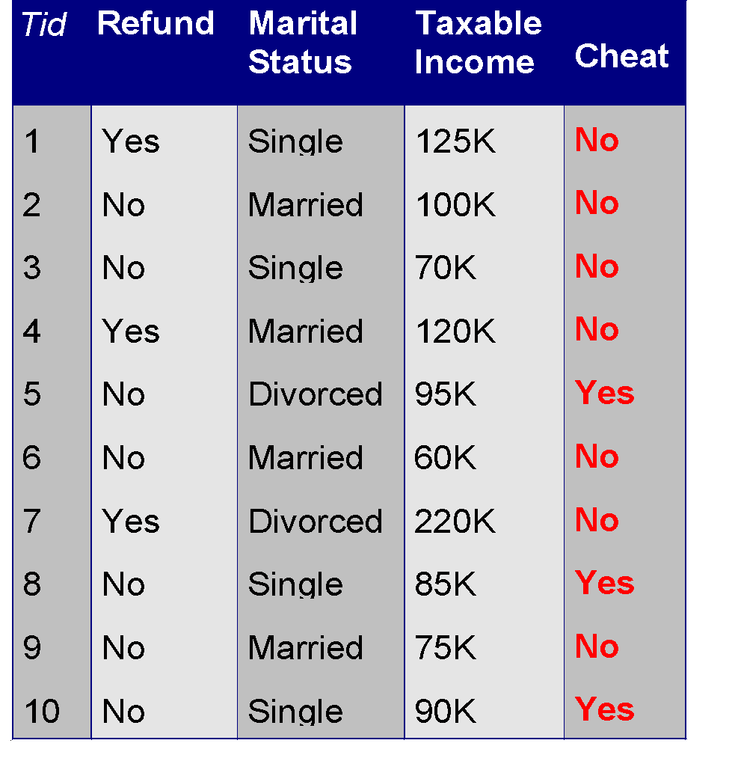
Example of a Decision Tree
Refund
Yes
No
NO
MarSt
Single,
Divorced
Married
TaxInc
NO
< 80K
>= 80K
NO
YES
Training Data
Model: Decision Tree

Slide 3
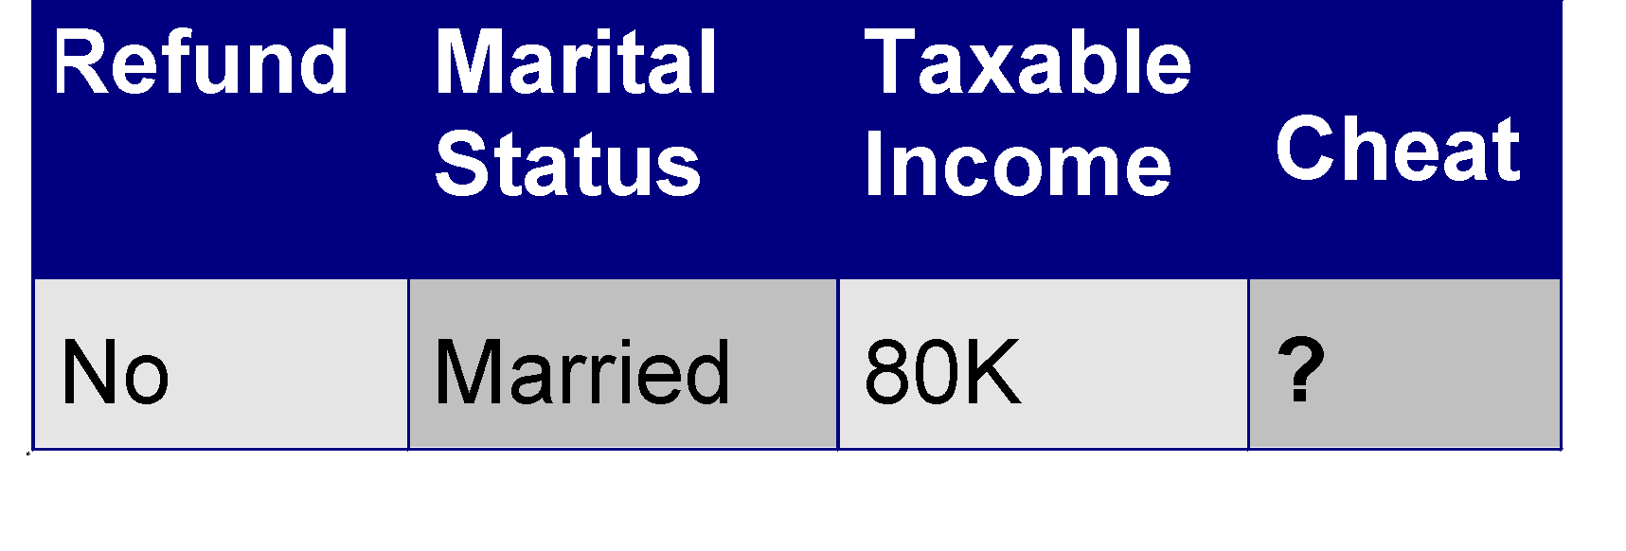
Example of a Decision Tree
Refund
Test Data
Yes
No
MarSt
NO
Single, Divorced
Married
TaxInc
NO
< 80K
>= 80K
NO
YES

Slide 4
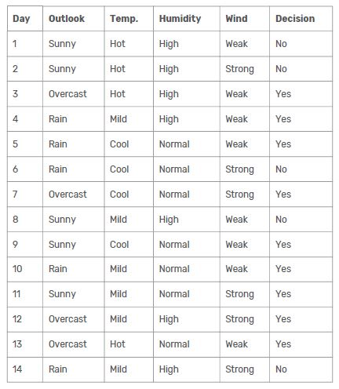
How to Build a Decision Tree

Slide 5
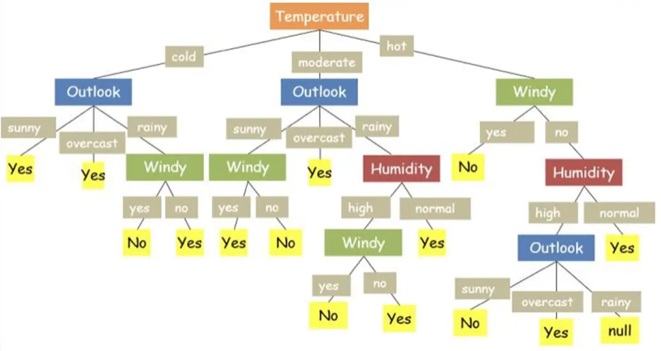
Decision Tree 1

Slide 6
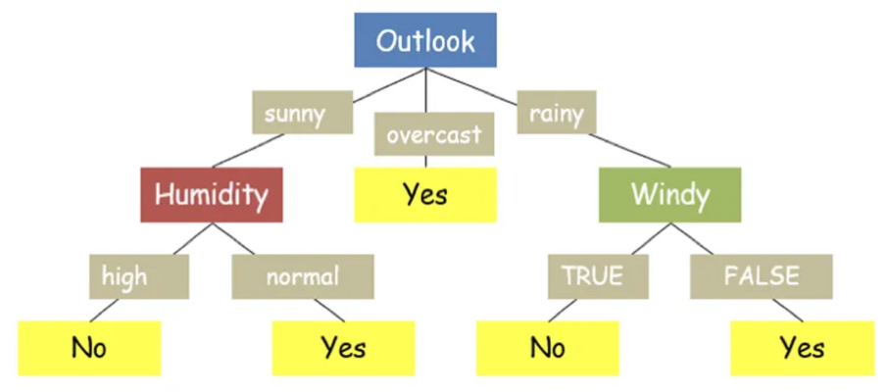
Decision Tree 2

Slide 7
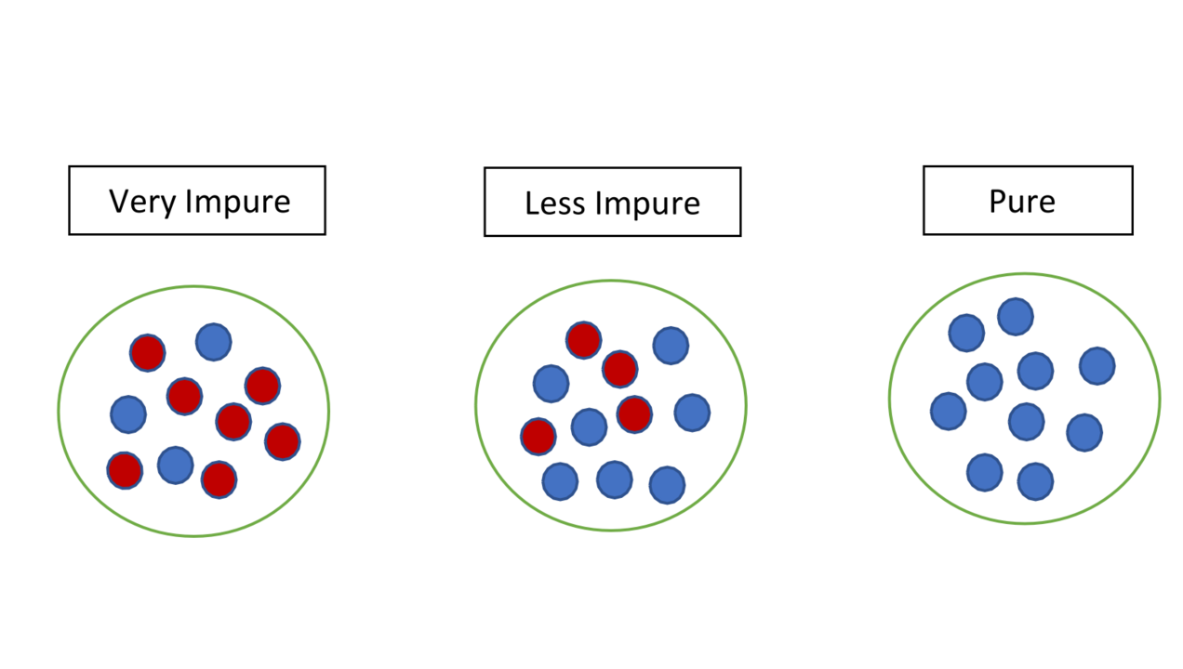
Which Feature is Better?
Total match > 300
Total Runs > 5000
High avg (>50)

Slide 8


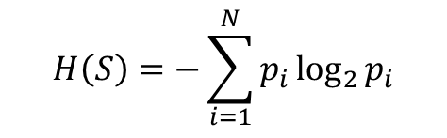

Entropy
Consider a Feature S with N classes:
Each class has an associated probability:
Entropy of the feature S,
Consider a dataset of 100 batsmen. Consider the feature “batting hand”, where 55 are right handed and rest are left handed
Consider their average, where 15 has high average (>45), rest low average (<35)
Lower entropy -> higher discrimination -> easier to decide -> better feature

Slide 9

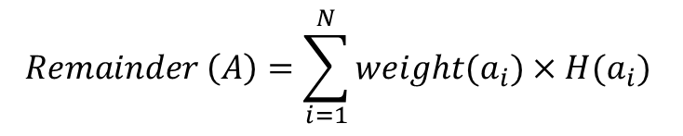
How to Choose a Feature?
Let, output is S (boolean), there are THREE features A, B, C
Calculate entropy of S, H(S)
Feature A has N classes:
Calculate Remainder of A:
Information gain of A for S, Gain(S, A) = H(S) - Remainder(A)
Similarly calculate Gain(S, B), Gain(S, C), Gain(S, D)
Choose the feature with highest gain

Slide 10
How to Build a Decision Tree

Slide 11
How to Build a Decision Tree: ID3 Algorithm
Here output is Decision
There are four features
We need to choose a feature first that will make our decision easier (reduce the tree size)
Calculate H(decision)
Calculate Gain(Decision, Outlook), Gain(Decision, Temp), Gain(Decision, Humidity), Gain(Decision, Wind)
Choose the feature w/ most gain

Slide 12
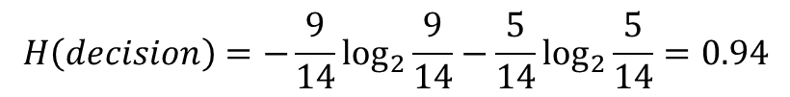
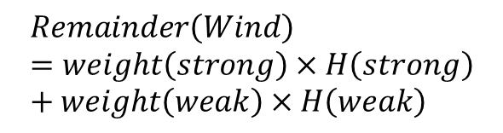
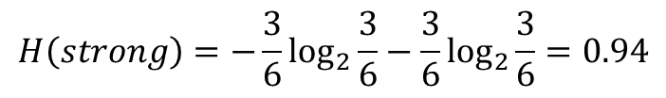
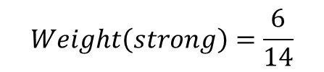
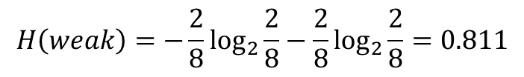
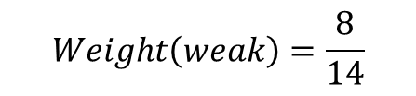
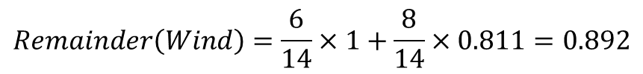
How to Build a Decision Tree: ID3 Algorithm

Slide 13




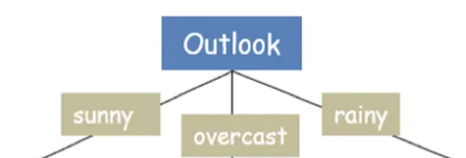
How to Build a Decision Tree: ID3 Algorithm
Choose OUTLOOK as root of Tree

Slide 14
How to Build a Decision Tree: ID3 Algorithm
Note: If Outlook = Overcast, Decision is always YES
What if Outlook is Sunny or Rain?
Now we have to choose a second feature to look at: Temp or Humidity or Wind
Calculate Gain(Sunny, Temp), Gain(Sunny, Humidity), Gain(Sunny, Wind) -> choose the feature with highest gain
Calculate Gain(Rain, Temp), Gain(Rain, Humidity), Gain(Rain, Wind) -> choose the feature with highest gain

Slide 15
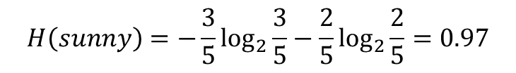
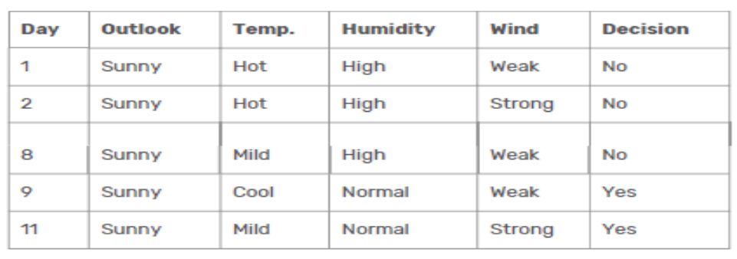


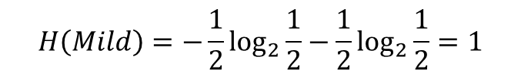
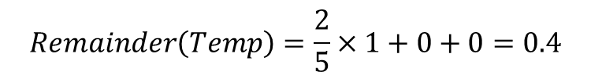
How to Build a Decision Tree: ID3 Algorithm
Let’s calculate Gain(Sunny, Temp)

Slide 16
How to Build a Decision Tree: ID3 Algorithm
Gain(Sunny, Temp) = 0.57
Gain(Sunny, Humidity) = 0.97
Gain(Sunny, Wind) = 0.019
Choose Humidity for sunny

Slide 17
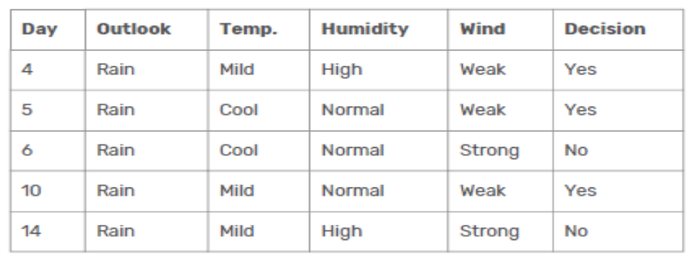
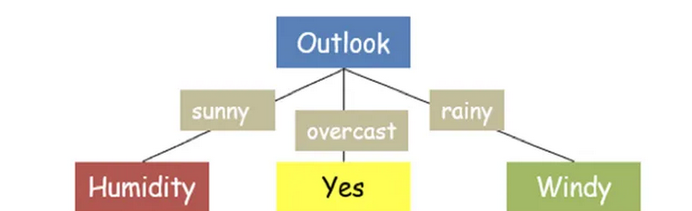
How to Build a Decision Tree: ID3 Algorithm
Similarly, Calculate Gain(Rain, Temp), Gain(Rain, Humidity), Gain(Rain, Wind)
Gain(Rain, Wind) is highest, choose Wind for Rain

Slide 18
How to Build a Decision Tree: ID3 Algorithm
Notice that, if Outlook = Sunny and Humidity = High, Decision is always NO
Similarly if Outlook = Sunny and Humidity = Normal, Decision is always Yes
Moreover, if Outlook = Rain and Wind = Weak, Decision is always Yes
If Outlook = Rain and Wind = Strong, Decision is always No
At this point, the tree construction is over

Slide 19
Final Decision Tree

